Slide 2

Biomedical Engineering
Chemical & Life Science Engineering
Computer Science
Electrical & Computer Engineering
Mechanical & Nuclear Engineering

Slide 3
Biomedical Engineering
Chemical and Life Science Engineering
Computer and Information Systems Security
Computer Science
Engineering with track in electrical
and computer engineering
Mechanical and Nuclear Engineering
M.P.I. - Master of Product Innovation,
affiliated with the da Vinci Center

Slide 4
Biomedical Engineering
*NEW* Chemical and Life Science Engineering
Engineering with track in
computer science
Engineering with track in electrical
and computer engineering
Mechanical and Nuclear Engineering
(Only such program in the U.S.)

Slide 5
One-year program for high school students
Mentorship from faculty, postdoctoral fellows and grad students
Inspires students to study engineering — often at VCU
One-year program for undergraduates
Offers a long-term, immersive research experience
Mentorship from faculty, postdoctoral fellows and grad students

Slide 6
1,804
Undergraduate students
309
Graduate students
175
Ph.D. students
113
M.S. students
314
Biomedical Engineering
Undergraduate Students
209
Chemical &
Life Science Engineering
Undergraduate Students
423
Computer Science
Undergraduate Students
306
Electrical & Computer Engineering
Undergraduate Students
519
Mechanical & Nuclear Engineering
Undergraduate Students

Slide 7

Pathways for a mix of conventional and non-conventional students (community college transfers, first-generation college students, veterans and career-changers)
Student engagement through experiential learning, academic support, leadership opportunities and career development

Slide 9
Young, diverse metro area: #2 city where millennials are moving (Time, 2017)
Low cost of living
#6 fastest growing tech talent market in North America (CBRE, 2018)

Slide 10
First building and current administrative headquarters
Department of Chemical and Life Science Engineering
Department of Electrical and Computer Engineering
Student welcome center, student services and career services
24 research laboratories
200-seat auditorium

Slide 11
Department of Biomedical Engineering
Department of Computer Science
Department of Mechanical and Nuclear Engineering
48 research laboratories

Slide 12
Supports collaborative efforts among engineering, medicine and life science disciplines
Features one of the largest configurable research spaces in the U.S.
Offers sophisticated instrumentation including scanning electron microscopy

Slide 13
More than 8,000 square feet of fabrication and research space
Focuses on development of micro- and nano devices and state-of-the-art material creation
Two Class-1000 cleanrooms
Offers high-tech equipment and analytical services to researchers from industry, both VCU campuses and other universities
Housed in the VCU Institute for Engineering and Medicine

Slide 14
Strong VCU Engineering presence in the 34-acre life sciences community of private sector companies, research institutes, nonprofits and government laboratories
Adjacent to the VCU Medical Center

Slide 15
Department of Biomedical Engineering offices
Department of Mechanical and Nuclear Engineering offices
Medicines for All Institute, which designs more efficient ways to manufacture drugs to treat disease in developing countries
Pharmacy on Demand, a collaboration with the Massachusetts Institute of Technology to create small, shippable pharmaceutical manufacturing platforms for locally produced medicines worldwide
VCU’s Center for Rational Catalyst Synthesis (CeRCaS), the world’s first research center dedicated to understanding the chemical fundamentals of catalyst synthesis

Slide 17
Ph.D. in Chemical and Life Science Engineering
Meets growing industry demand for advanced skills in this area
Starts in fall 2019
Fundamentals of Computing Specialization
Open to students in ALL majors
Students also earn the Digital Technology Credential from the Greater Washington Partnership
Post-Baccalaureate Certificates
Certificates in cybersecurity and data science
Aimed at technology professionals

Slide 18
Will feature
  A 9,000-square-foot makerspace for hands-on, experiential learning
  Interdisciplinary research laboratories
  An expanded career services center
  Wired outdoor work and gathering spaces
  Ram Bytes café
Scheduled to open in late 2020

Slide 19
An old-meets-new automotive makerspace
Welding and woodworking stations, car lifts, flat-screen projectors and 3D printers
Home to VCU’s Formula SAE, Hyperloop and other large-scale student projects
Scheduled to open in fall 2019

Slide 20
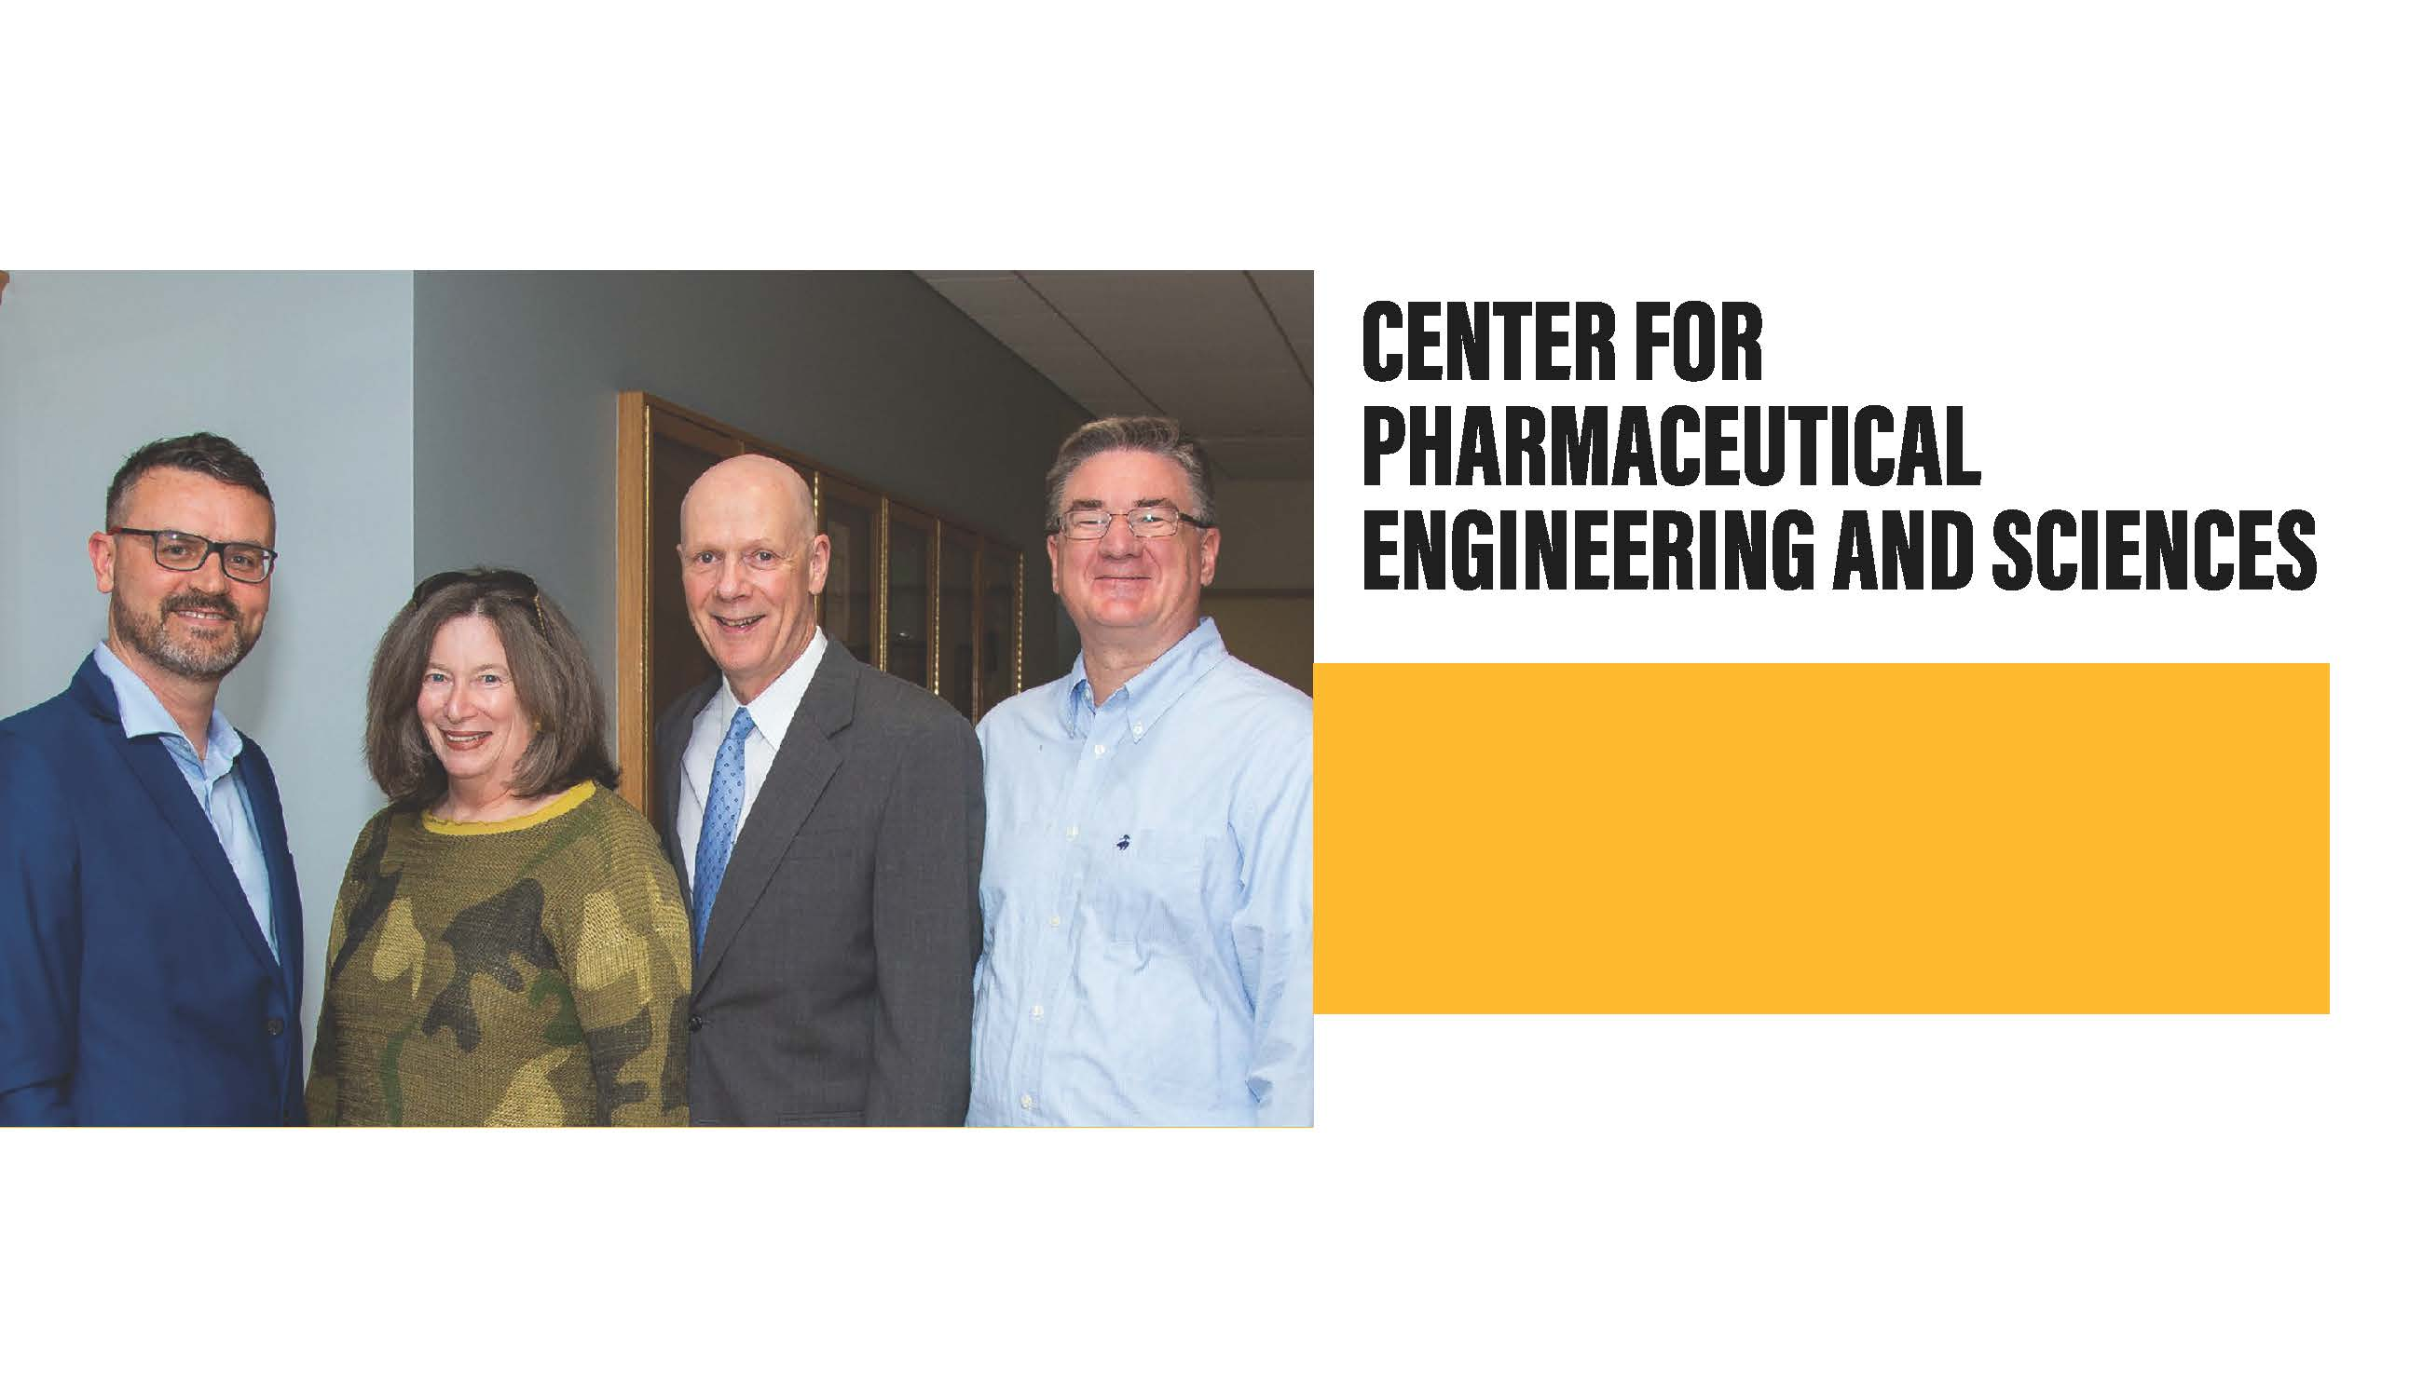
Only one in Virginia
VCU Engineering and VCU School of Pharmacy partnership

Slide 21
Expertise: bioimaging, cybersecurity, pharmaceutical engineering and alternative energy
Cutting-edge research in fields that address the challenges of our century

Slide 22
National American Nuclear Society student conference
International IEEE Magnetics Society Summer School
IEEE International Conference on Human System Interaction (HSI)
VM Workshop

Slide 24
Statewide push to invest in research capabilities and commercialization to bolster cybersecurity talent pool
Erdem Topsakal, Ph.D., chair of Department of Electrical and Computer Engineering, on CCI executive committee

Slide 25
Targeted programs that meet growing demand for computer scientists and engineers
  Fundamentals of Computing specialization open to ALL majors
  Post-baccalaureate certificates in cybersecurity and data science
  Collaborations with Greater Washington Partnership and Commonwealth Cyber Initiative

Slide 26
Hands-on engineering, STEM-related and lab experiences for K-12 students
Professional development opportunities for teachers
FIRST Robotics; high school programming contest

Slide 27
NEW dual degree program with Virginia Union University
NEW partnership with community colleges for inclusive excellence in science
Supporting underrepresented minorities through Louis Stokes Alliance for Minority Participation (LSAMP); Richmond Minorities in Engineering Partnership

Slide 28

Making smart cities smarter
Working with NASA on International Space Station; at Langley Research Center
Protecting the U.S. power supply grid from hackers

Slide 30
20
faculty fellows, including 8 American Institute for Medical and Biological Engineering (AIMBE)
7
active NIH R01s
$25 million
grant from Bill & Melinda Gates Foundation for Medicines for All Institute

Slide 31
Expert in musculoskeletal tissue engineering, regenerative medicine and cell and tissue interactions with biomaterials
Inventor on multiple patents; National Academy of Inventors Fellow
Co-founder of several companies

Slide 32
Hong-Sheng Zhou, Ph.D., Google Faculty Research Award
National Science Foundation Graduate Research Fellows: Steven Hernandez; Brooke Danielsson
Goldwater Scholar Anastasios Karles

Slide 34
Culminating experience for undergraduates
Projects sponsored by industry, government and nonprofits to address unmet needs
Partnerships with business students result in new startup companies

Slide 35
Multidisciplinary, long-term, large-scale research projects
Brings together undergraduates, graduate students, postdoctoral fellows and faculty
Often sponsored by industry partners

Slide 36
One- to two-day design-a-thons that begin with industry-pitched challenges
Five per year, one for each major
Results: Solutions to real problems and a chance to recruit new talent

Slide 37
90%
of undergraduates are in-state
75%
of graduates stay in Virginia
Strong growth in cybersecurity, data science, automation and controls, nuclear engineering and other in-demand specialties

